Slide 1
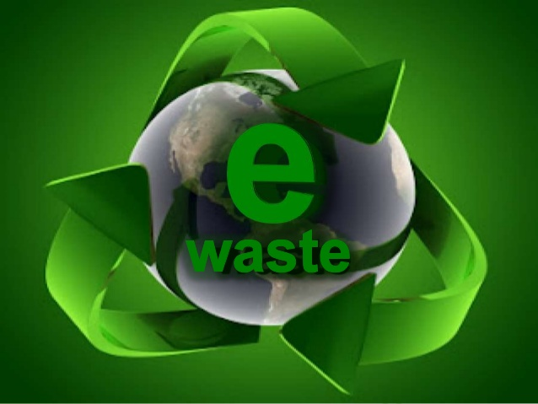
GREEN-A-THON 2018
Project By :
AYUSH KUMAR JAIN
PAWAN VERMA

Slide 2
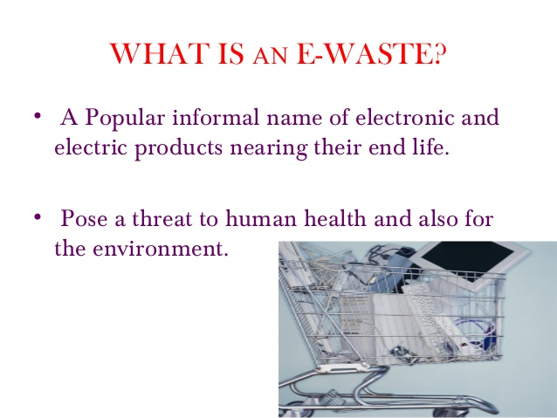


Slide 3
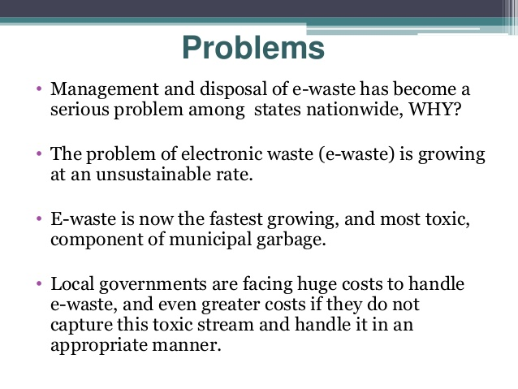

Slide 4

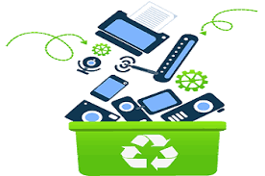
Why E-Waste is a Problem?
We make a lot of e-waste. When electronics end up in landfills, toxics like lead, mercury, and cadmium leach into the soil and water. The electronic waste problem is huge: More than 20 million tons of e-waste are produced every year.

Slide 5
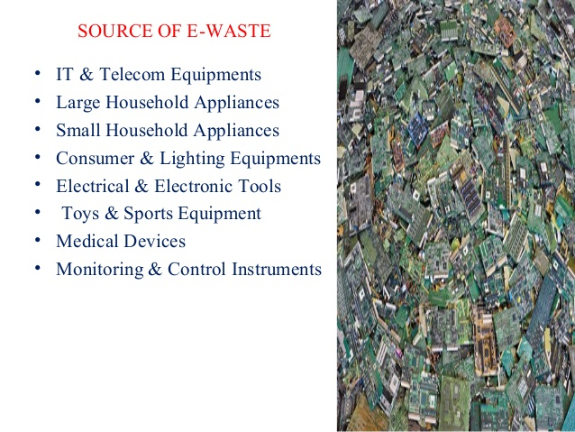
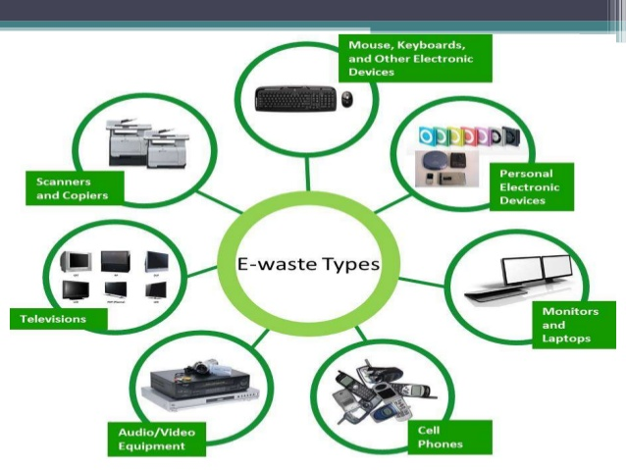

Slide 6
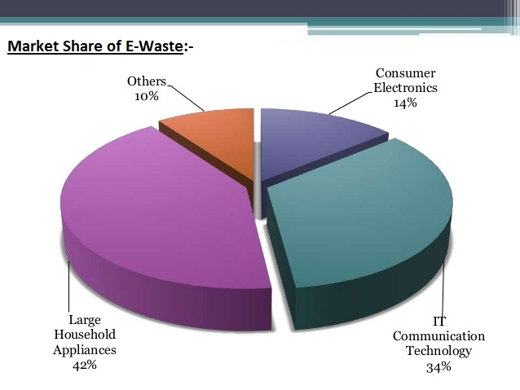

Slide 7
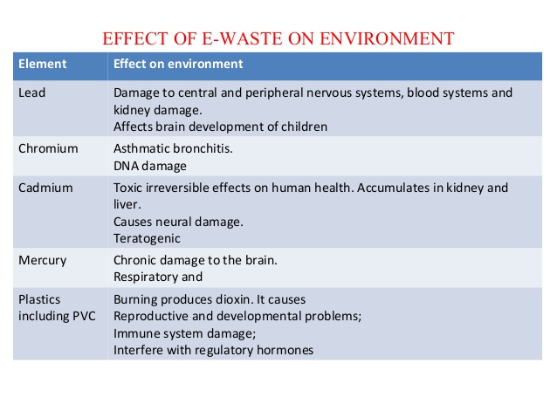

Slide 8
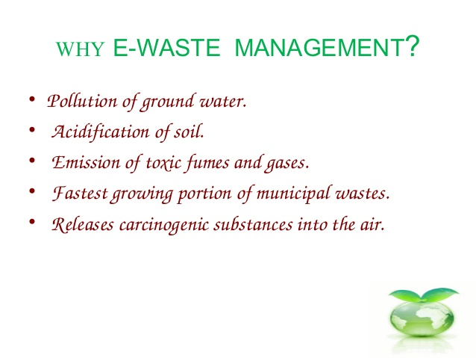

Slide 9
Components After Recycling the E-Waste
E-waste Component | Waste Part
Gold | Computer Equipments
Aluminum | Electronic Goods
Nickel | Cadmium Batteries
Lithium | Lithium-ion Batteries.
Zink | Plating of Steels Parts
Silicon | Glass, Transistors, ICs, Circuit Boards
Copper | Copper wire, Printed Circuits Boards tracks

Slide 10
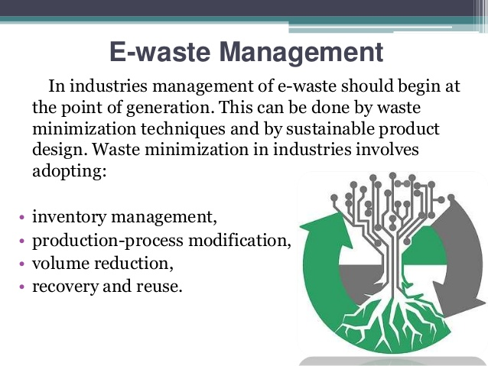

Slide 11
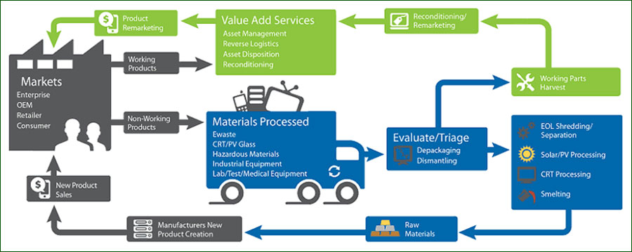
Process of Recycling of E-Waste:-

Slide 12
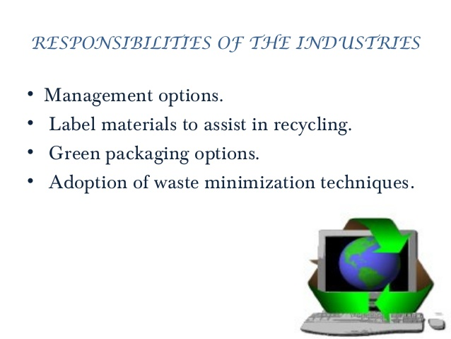
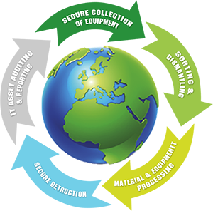

Slide 13
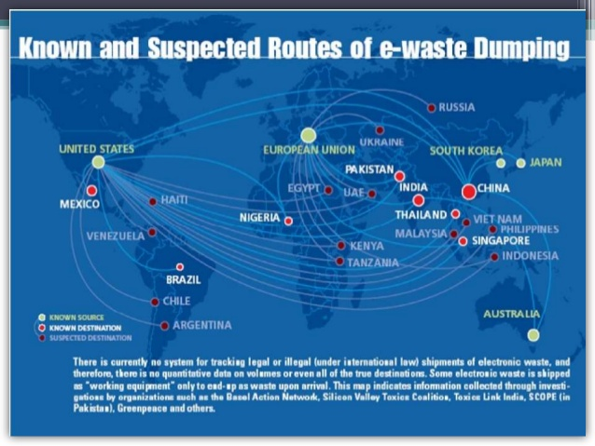

Slide 14
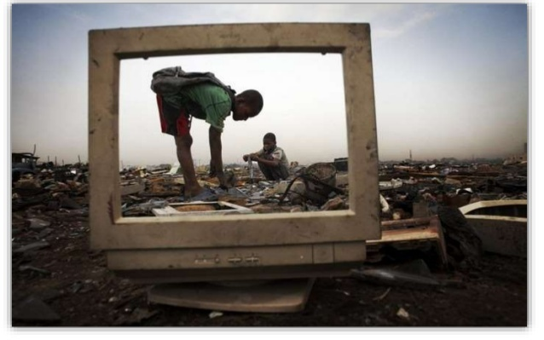
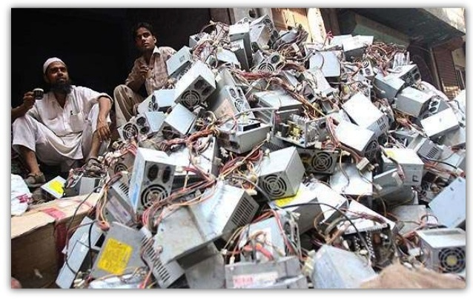
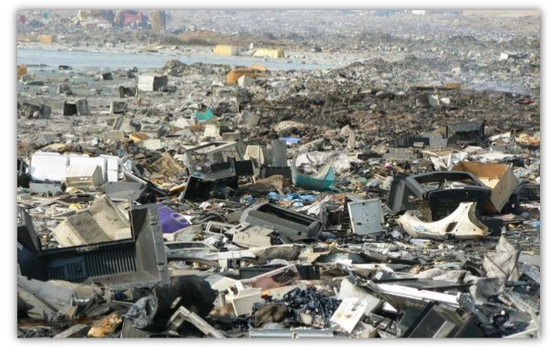
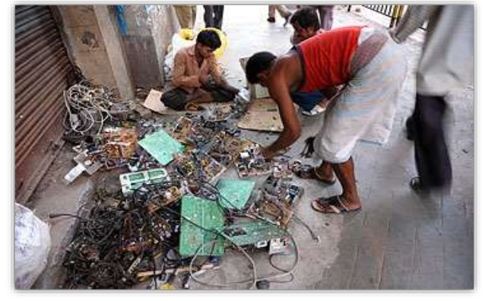

Slide 15
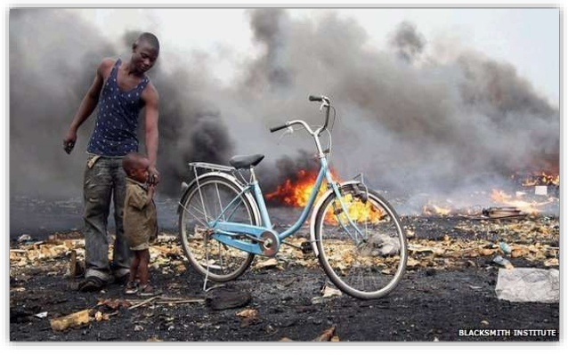

Slide 16
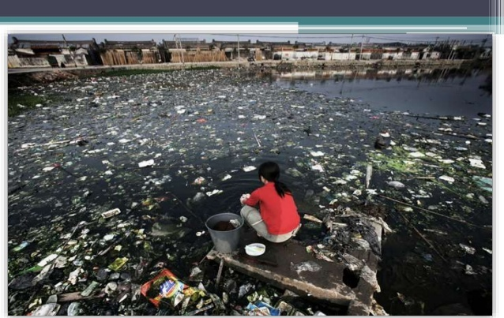
Once in a village , the population has made unable to produce Crops for Food and the water of the river is undrinkable.

Slide 17
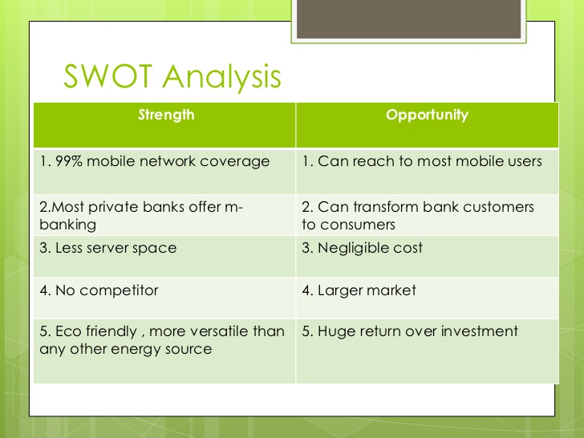
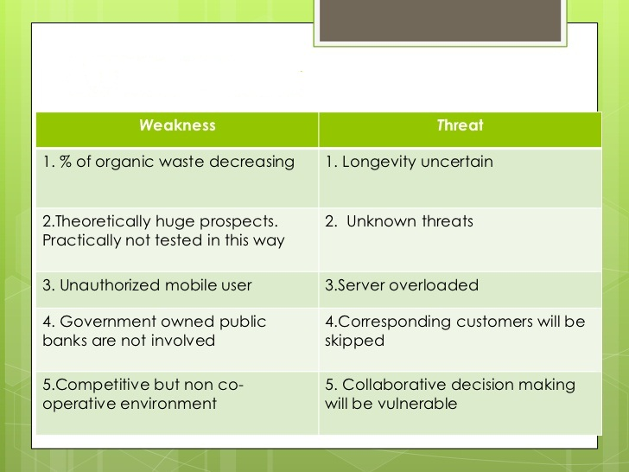

Slide 18
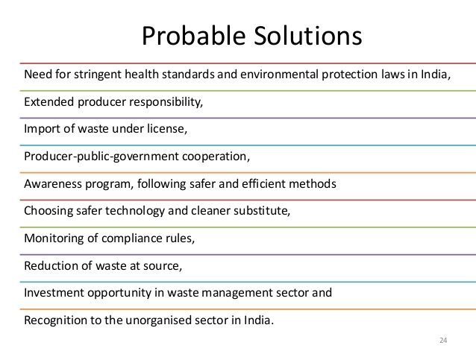

Slide 19
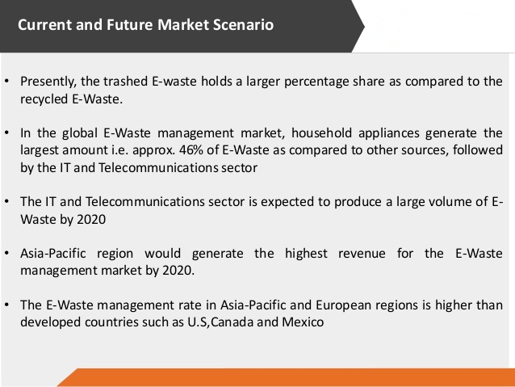

Slide 20
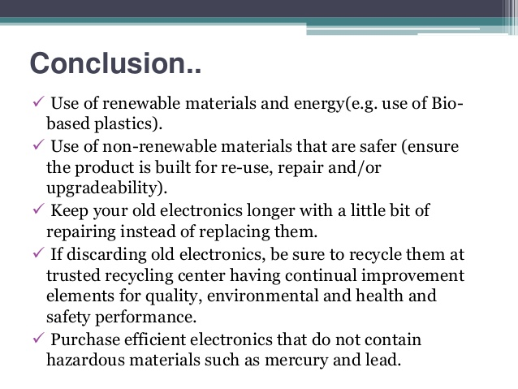

Slide 21



